Slide 1
System Development Methods CT00046-3-2
People Oriented Methodologies

Slide 2
Topic & Structure of the Lesson
People Oriented Methodologies:
Characteristics of People Oriented Methodologies.
Multiview framework in the Web Information Systems Development Methodology (WISDM).
Development models in the Knowledge Acquisition and Documentation Structuring (KADS).
Development path in the Soft Systems Methodology (SSM).

Slide 3
Learning Outcomes
By the end of this lecture, YOU should be able to :
Describe the characteristics of People Oriented Methodologies.
Explain the Multiview framework used in the Web Information Systems Development Methodology (WISDM).
Distinguish the development models in the Knowledge Acquisition and Documentation Structuring (KADS).
Discover the development path in the Soft Systems Methodology (SSM).

Slide 4
Key Terms you must be able to use
If you have mastered this topic, you should be able to use the following terms correctly in your assignments and exams:
Characteristics of People Oriented Methodologies
Web Information Systems Development Methodology (WISDM)
Knowledge Acquisition and Documentation Structuring (KADS)
Soft Systems Methodology (SSM)

Slide 5
Characteristics of People Oriented Methodologies

Slide 6
People Oriented Methodologies
These methodologies are used when:
Developer trying to make the system mimic the user’s needs and behaviors.
The system is going to be used by many types of users (age, literacy, culture, needs, etc.)
Widely used in environment involving gaming, robotics, virtual reality, augmented reality, medicine, animal behaviors, etc.
Used when:-
Requirements are not fixed / cannot be fully determined earlier
Requirements and scenarios are constantly changing.
Structured methodologies might not be suitable as they require many facts to be constant.

Slide 7
People Oriented Methodologies Facts often considered
User’s Age
Kids, Youth, Senior
Users’ Behavior
Students, managers, sports athletes, etc.
User’s Computer Literacy
Novice, Intermediate, Expert
User Physical capabilities
Body size, level of sight, hearing, etc.
Users Culture
Language, texts, colors, concerns, etc.
User Emotion
Perception, preferences, emotions, attraction, fear, concerns.
Environment
Private, social, group, corporate, etc.
Laws and Legislations
Copyright, Consumer Rights, etc.

Slide 8
People Oriented Methodologies General strategies
General strategies of development in this methods:
Developers study user behaviors of a system in the real-world.
Capture user's behavior into ‘tasks’ in virtual world.
Connect / link several tasks to become a complete process.
Build IS to satisfy the process in the real-world.
Continually update IS system with new and improved tasks (continuous development).

Slide 9
Web Information Systems Development Methodology (WISDM)

Slide 10
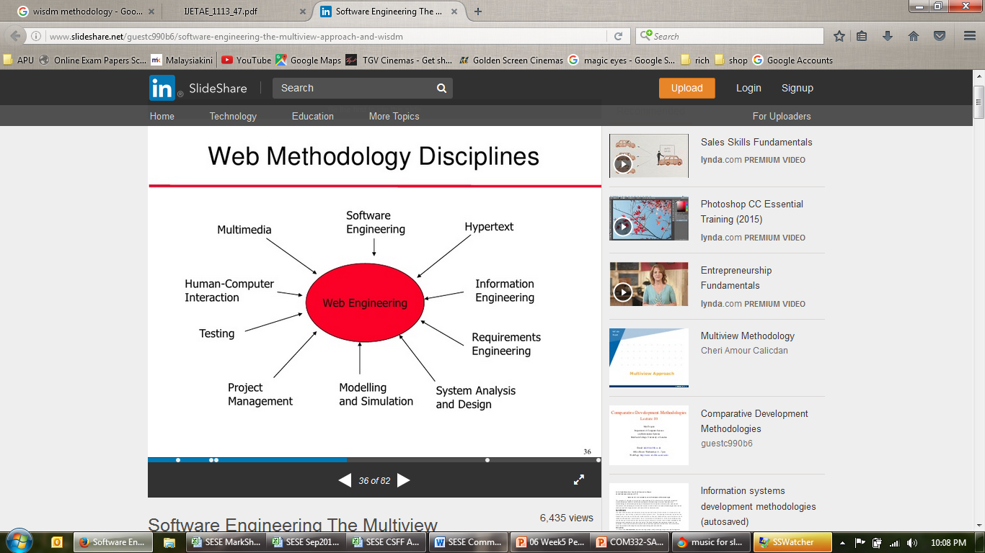
Web Information Systems Development Methodology (WISDM)
Idle for building websites and web applications that are very dynamic - incorporates many components, languages and features.
WISDM is based on the ‘Multiview’ framework

Slide 11
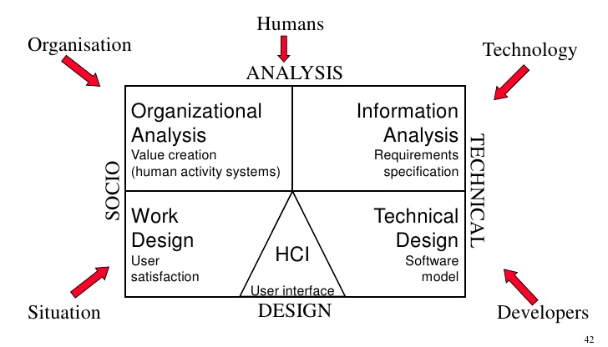
WISDM
Multiview Framework
Multiview looks at a scenario from many views / angles and creates an automated design based on the captured tasks.

Slide 12
WISDM
Multiview Framework
Organizational Analysis
Mainly focused on building strategies that are characterized by complexity and stakeholder interests.
Generally, concern with value creation, where a systematic transformation creates benefit (or disbenefit) for users.
The consideration of how value will be created can be based on the following:
Business (strategy): What business is the Organization in?, What are the visions and missions?
Products and services: What are the sources of revenue?, What are the benefits to the business actors?
Other factors: Who are the customers? Who are the competitors?, etc.

Slide 13
WISDM
Multiview Framework
Information Analysis
Include requirements gathering which can be converted as functionalities in a new system.
The requirements will be compiled and can be described in graphical representations. WISDM uses UML Model to represent the functionalities of the new system. Elements of the analysis model include:
Data model
Flow model
Class model

Slide 14
WISDM
Multiview Framework
Work Design
Produce a ‘good fit’ considering people and their needs together with the computer systems and necessary work tasks.
Concerned with achieving a suitable match between job satisfaction – the fit of an employee’s job expectations and the job requirements as defined by management - and the efficiency objectives of the organization.
Thus, design of the system according to the job expectations and job requirements is focused on
usability, quality of information and ease of access.

Slide 15
WISDM
Multiview Framework
Technical Design
Technical tasks that focus on efficient development based on the given system specification. The development include:
Programming design software
Database design software
Server
Other web technologies such as messaging, transport, protocols, web services, etc.
System can be broken down into some subsystems, for example: information retrieval subsystem, database subsystem, control subsystem, recovery subsystem, monitoring subsystem.

Slide 16
WISDM
Multiview Framework
Human Computer Interaction (HCI)
Focus on the ways in which users will interact with the system (screens, inputs, and outputs, etc.). It is an interaction between technical design and work design.
HCI design should be matched with users’ technical skills, experience and expectations which are user-friendly, flexible, secure, usable, and accessible.
Design principles can be applied when designing the HCI including use of proper colour, font, size of screen, some layout formatting i.e., caption, table, form-fill, etc.

Slide 17
Knowledge Acquisition and Documentation Structuring (KADS)

Slide 18
Knowledge Acquisition and Documentation Structuring (KADS)
The development of a knowledge-based system is defined in KADS as the construction of a set of different kinds of models (de Hoog et al., 1993).
Structured way of developing knowledge-based (k-base) systems (expert systems).
Its components are:
A methodology for managing knowledge engineering projects.
A knowledge engineering workbench.
Methodology for performing knowledge elicitation.
Components in the real world are converted into ‘chunks’ to be designed and turned into automated functions.
Uses object-oriented approach for designing and construction.
KADS was further developed into CommonKADS.

Slide 19
KADS What is Knowledge?
What is knowledge? The usual answers are variations on a number of themes:
Knowledge is a highly-structured form of information
Knowledge is what is needed to think like an expert
Knowledge is what separates experts from non-experts
Knowledge is what is required to perform complex tasks
Knowledge is a machine in someone’s head that takes in data and information at one end and spurts out decisions and actions at the other end.

Slide 20
KADS What is Knowledge? (continued)
Procedural knowledge vs. Conceptual knowledge
Procedural knowledge is the knowledge you would name if you were completing the sentence: “I know how to…”. So, if I say: “I know how to drive a car” then this type of knowledge is procedural.
Hence, it is about processes, tasks and activities. It is about the conditions under which specific tasks are performed and the order in which tasks are performed. It is about the resources required to perform tasks and it is about the sub-tasks that are required.

Slide 21
KADS What is Knowledge? (continued)
Conceptual knowledge is what you would say if you were completing the sentence: “I know that…”. So, if I say: “I know that a sports car goes faster than a lorry” then this type of knowledge is conceptual.
Hence, it is about the ways in which things (which we call ‘concepts’) are related to one another and about their properties.

Slide 22
KADS What is Knowledge? (continued)
Basic, explicit knowledge vs. Deep, tacit knowledge
Basic, explicit knowledge is concerned with basic tasks that an expert performs, basic relationships between concepts, and basic properties of concepts.
This type of the knowledge is not too difficult to explain and is the sort of thing that is taught in classrooms and lecture theatres.
Deep, Tacit Knowledge is at the other extreme to basic, explicit knowledge. It is knowledge that is thought about at the back of one’s brain, in what some people call the ‘subconscious.
It is often built up from experiences rather than being taught. Hence, it is the sort of knowledge that someone gains when they practice something.

Slide 23
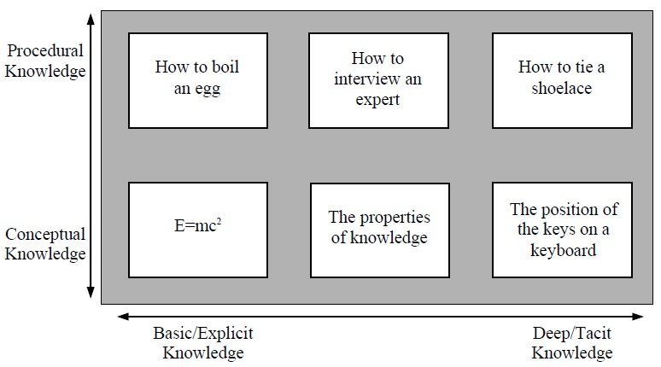
KADS What is Knowledge? (continued)
Examples of different types of knowledge using a 2-dimensional graph

Slide 24
KADS Knowledge Acquisition
Knowledge acquisition is about creating a store of knowledge that can be used to provide an end-product that has many different applications and benefits.
There are several important factors that we must bear in mind when running a knowledge acquisition project:
The end-product must be useful to the end-users;
To be useful, the end-product must be full of high-quality knowledge that is correct, complete and relevant and that is stored in a structured manner;
The project must be run in an efficient way making the most use of the available resources;
The project should not unduly disrupt the normal running of the organisation, hence should not involve too much time from experts

Slide 25
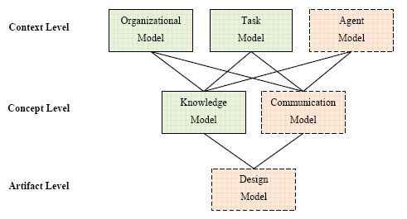
KADS Development Models
The model set is composed of six model templates that can be filled and refined during development.

Slide 26
KADS Development Models (continued)
The organisational model describes the socio-organisational environment in which the knowledge-based system will have to function. This includes a description of how the k-base will influence the organisation and the people working in it.

Slide 27
KADS Development Models (continued)
The task model consists of a decomposition of real-life tasks which are necessary to achieve the function of the system as specified in the application model into several primitive tasks and their distribution over several agents, i.e., the user(s) and the knowledge-based system.
There may be several alternative ways how a system may achieve a given goal. Only the characteristics of the application, the availability of knowledge and data, and the external requirements given by the user and the environment determine which alternative is appropriate.
It is the knowledge engineer who must decide between internal and external tasks, i.e., between the tasks which are assigned to and solved by the system and those which are solved by the user.

Slide 28
KADS Development Models (continued)
The agent model describes the reasoning capabilities of a system agent.

Slide 29
KADS Development Models (continued)
The expertise/knowledge model describes the problem-solving behaviour of an agent in terms of knowledge that is being applied in carrying out a task.
Concerned with two things: (i) Eliciting knowledge, i.e., capturing knowledge that is not in the k-base; (ii) Validating knowledge, i.e., checking that knowledge in the k-base is correct, complete and relevant to the project.
Several techniques can be used for eliciting and validating knowledge such as interview techniques involve questioning the experts.

Slide 30
KADS Development Models (continued)
The communication model describes inter-agent communication and system-user cooperation.

Slide 31
KADS Development Models (continued)
The design model specifies the computational and representational techniques that the artifact should use to realise the specified behaviour.
It defines the transition from conceptual descriptions to implementation. Thereby, the design model distinguishes between application, architecture and platform design.
Application design describes the high-level decomposition of the artifact into sub-systems and the description of each sub-system including its functionality and its type, for example, k-base-system and interaction system.
Architecture design describes the high-level computational realization of the artifact. This includes specification of the interface architecture and the computational architecture. Typical examples of the computational architecture are rule-based and blackboard architectures.
Platform design describes the lower-level decisions about the target language for implementation, hardware and software configuration, the user and software environment.

Slide 32
Soft Systems Methodology (SSM)

Slide 33
Soft Systems Methodology (SSM)
An organized way of tackling messy situations in the real world.
Based on system thinking, a holistic view of the situation. SSM focuses on the whole situation instead of the specific parts.
Used when:
Requirements are not clear / cannot be fixed.
The scenario of the system is too complex to be defined.
Users are not sure how the system should behave.
Stakeholders interpret problems differently.
Developers / users not sure of the requirement for the system (System functionality difficult to be determined)
Compared to HARD SYSTEMS where most of the requirements can be determined and fixed.

Slide 34
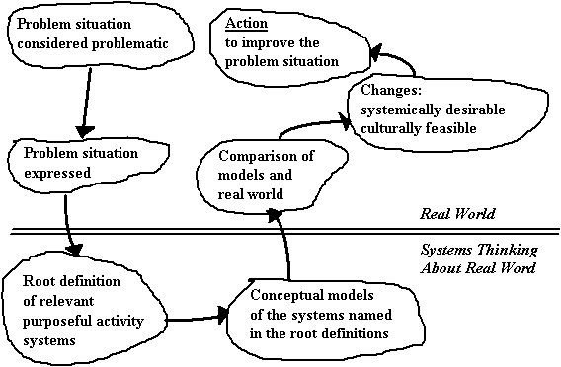
SSM Development Path
The seven-stage model shows that the methodology makes a distinction between activities that are related directly to the real world of the problem situation and activities which relate to the world of systems thinking.

Slide 35
SSM Problem Situation
Problems belong to situations. Any attempt to manage problems must manage situations.
Checklist for starting problem analysis
Any use of SSM starts by looking at the relationship between the problem context and the problem-solving system.
This process can be described in the form of a checklist which can then be used as a guide for starting the use of the methodology. This checklist given here is to be used as a guide. It does not have to be followed; rather it is there to help when needed.

Slide 36
SSM Problem Situation (continued)
Some questions might be asked during the problem analysis:
Who is the initiator? Is the initiator acting alone or for a group of people?
Who are the problem owners? What are the expressed concerns of the problem owners?
Who are the decision takers?
Why do the occupiers of these roles regard the situation as in need of change?
What do these roles expect of the individual entering the situation to help?
This checklist helps users to get going at the start of a soft systems analysis by providing some very general guidelines regarding important roles in the learning process.

Slide 37
SSM Modelling in SSM
Draw a ‘Conceptual Design’ of the scenario.
The design must consider several factors:
The model should represent the activities required to achieve the purpose in a systemic manner.
The model should meet the criteria for being a system, represent an ideal form of being well organized for the particular purpose specified.
Modelling should be flexible. There may be many models which are relevant in any given situation.

Slide 38
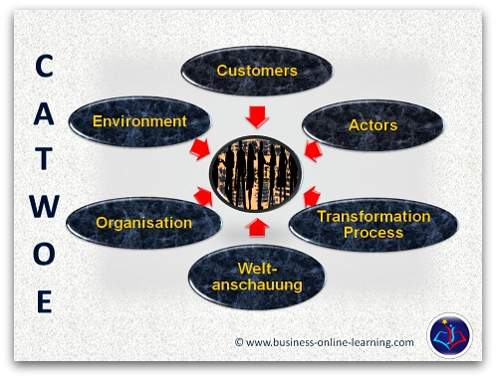
SSM The CATWOE Concept
The main elements of a well- formulated root definition have been found to be Customers, Actors, Transformation, Word-View, Owner, and Environment, hence the mnemonic CATWOE.

Slide 39
SSM The CATWOE Concept (continued)
Customers
Customers are those people, or other activity systems, who are the direct victims or beneficiaries of the system being developed. They are those people or systems associated with the inputs and outputs of the system.
Actors
The key people are involved in the implementation of the changes in the system or process. An actor is a person who carries out one or more of the activities in the system.

Slide 40
SSM The CATWOE Concept (continued)
Transformation
The fundamental concept of an activity system is that it converts some input into some output. This conversion process is termed the transformation and it is of vital importance.
In SSM focused upon purposeful action, that is, organized action that brings about some change in the world.
Therefore, idea of change and the concept of transformation are central concern.

Slide 41
SSM The CATWOE Concept (continued)
World-View
Includes the big picture of the situation, highlights problems, and describes the wider impact of the transformed system or process.
Owner
The owner of the system is that person, system, or agency which has the power to direct and ultimately abolish the system under consideration.
In many situations, it is relatively easy to identify the owner element, for example, a board of directors of a company, but in others, this might be a diverse and informal set of owners who could through agreement abolish the system.

Slide 42
SSM The CATWOE Concept (continued)
Environment
Include some restrictions that may halt operating the system. There will inevitably be elements outside of the system, these elements referred to environmental constraints.
For example, consider a manufacturing system that transforms raw materials into finished goods. The environment of a system will be the raw material suppliers, the suppliers of resources, and the disseminators of the finished goods.
It may be necessary to take these elements as given and consider the relationships and constraints that these elements impose upon the activity system.

Slide 43
Summary
People-oriented methodologies are used when developers try to make the system mimic the user’s needs and behaviors, and the system is going to be used by many types of users (age, literacy, culture, needs, etc.).
The WISDM is based on the ‘Multiview’ framework that allows developers to look at a scenario from different views including organizational analysis, information analysis, work design, technical analysis, and human-computer interaction.
The KADS provides a structured way of developing knowledge-based systems (expert systems), with a knowledge elicitation component. This component is about creating a store of knowledge obtained from experts that can be used to develop the system.
The SSM is an organized way of tackling messy situations in the real world. It is used when requirements are not clear, the scenario of the system is too complex to be defined, users are not sure how the system should behave, and they interpret problems differently.

Slide 44
Question & Answer

Slide 45
Next Session
Comparing Methodologies

Slide 46
References
Milton, N. R. (2007). Knowledge acquisition in practice: a step-by-step guide. Springer Science & Business Media.
Davies, L., & Ledington, P. (1991). Information in action: Soft systems methodology. Macmillan International Higher Education.

